Slide 1

IOT Smart Office
Nhat Phan-Mar 2016

Slide 2
CONTENTS
Product Architecture
AGILE Planning (Vision, Roadmap, Process)
Team org chart
Tools for project (Agile, Collaboration, Dev, Test)
Status update(Training, Tools, Process, Resource…)
References
Q & A

Slide 3
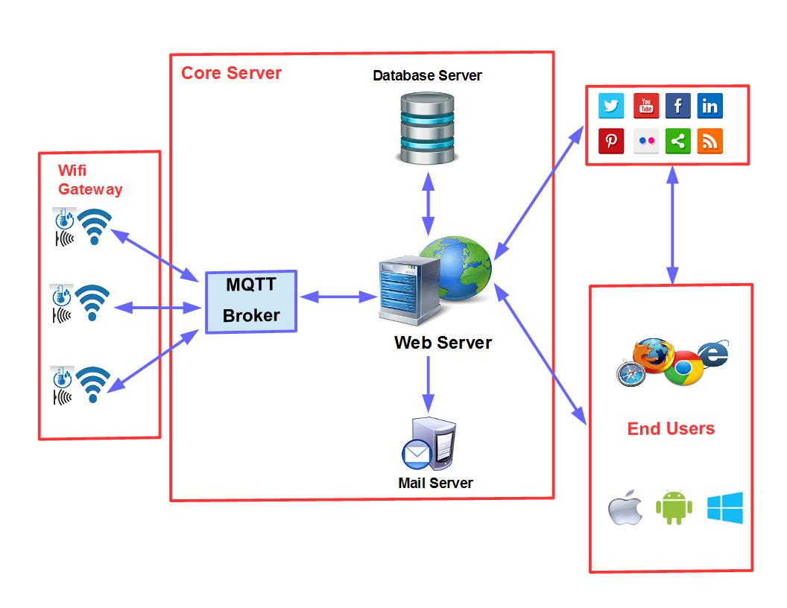
Product Architecture

Slide 4
AGILE – Product Portfolio and Vision
Portfolio: IOT application
Vision: Smart Office product
Customer of product: TMA.
User of product: All employees especially IT, Security and Project primes.
For user who managing/using facilitators of company, the smart office product will be an assistant for them in usual tasks. Its features will help for saving cost and time, provide more services to create a professional working environment and increase user/customer satisfaction.

Slide 5
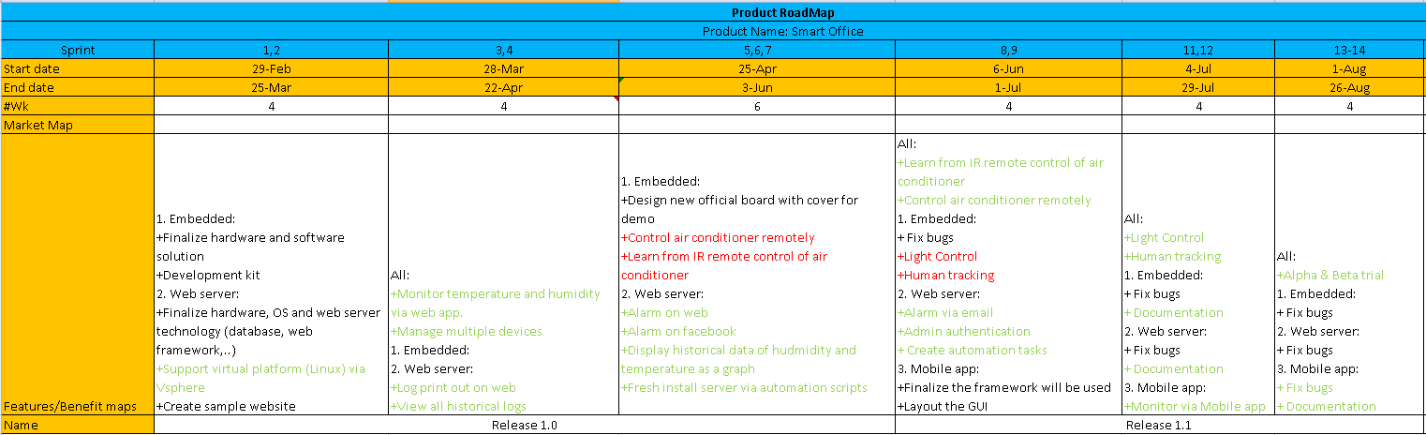
Product Roadmap

Slide 6
Process
2 Weeks Sprint
Week # | 1 |  |  |  |  |  |  |  |  |  | 2
Day | Mon |  | Tue |  | Wed |  | Thu |  | Fri |  | Mon |  | Tue |  | Wed |  | Thu |  | Fri
 | Mor | Aft | Mor | Aft | Mor | Aft | Mor | Aft | Mor | Aft | Mor | Aft | Mor | Aft | Mor | Aft | Mor | Aft | Mor | Aft
Tags | Sanity day |  | Fix bug day |  | Dev day 1 |  | Dev day 2 |  | Dev day 3 |  | Dev day 4 |  | Dev day 5 |  | Dev day 6 |  | Integration day 1 |  | Integration day 2
Dev team | -Sprint planning meeting(1h) -Run Sanity Suite on new build | Fix Sanity bugs and run Sanity overnight | -Fix bugs/enhancements in backlog from Sanity/Integration/Regression |  | Dev TCs/new function with productivity 2 TCs/person day Require testing local TCs and integrated into common suite Run integration testing all developed TCs at the end of 2nd Wed |  |  |  |  |  |  |  |  |  |  |  | Fix bugs of the 1st Integration test | Fix bugs then rerun overnight | -Debug suites and open bugs if required (2h) -Create ~2 new Sanity TCs/ person day base on new functions (6h)
Maintenance | -Sprint planning meeting(1h) -Run Sanity Suite on new build | Fix Sanity bugs and run integrated suites overnight | Run/Fix all suites
Management | Sprint planning meeting 1 | Sprint planning meeting 2 |  | Weekly report |  | Update progress |  |  | Review all backlogs | Update progress |  |  | Weekly report |  | Update progress |  |  | Demo if required | Review all backlogs | Backlog refinement meeting
Sprint 15
 | Resources | 4.5 | (4 TMA, 1 Pune)
 | Working days | 44.75
 | Holidays | 0
 | Others | 2
 | Capacity (hours | 340 | 4*3(TMA)+4(Pune)=16 hours for meeting
# | Developer | Week #1 |  |  |  |  |  |  |  | Week #2
 |  | Mon |  | Tue | Wed |  | Thu | Fri |  | Mon |  | Tue | Wed | Thu | Fri
1 | Kim Tran | Meeting | SVAUTO-821 |  |  |  |  |  | SVAUTO-813 | SVAUTO-813 | SVAUTO-779 |  |  | SVAUTO-814
2 | Hung Nguyen | Meeting | SVAUTO-823 | SVAUTO-817 ACA Sanity |  |  | SVAUTO-817 ACI Sanity |  |  | SVAUTO-795 Dev TCs (6) |  |  |  | SVAUTO-795 Test | SVAUTO-795 sanity
3 | Dong Huynh | Meeting | ACW 2.1 | SVAUTO-818 ACW Sanity |  | SVAUTO-818 ACM Sanity |  | SVAUTO-795 Dev TCs (8) |  |  |  |  |  | SVAUTO-795 Test | SVAUTO-795 sanity
4 | Minh Nguyen | Meeting | SVAUTO-823 Lync maintenance and run 50 TCs |  |  |  |  |  |  | SVAUTO-809 run Lync suite on win 7 (Completed 14%- will get support from Loc next sprint) |  |  |  |  | SVAUTO-795 sanity

Slide 7
Team Org chart (1)
Embedded: Embedded programming
Web sever (team Core): Web framework (database, analysis, security, logs, alarm,…)
Web sever (team IO): Interact with embedded devices, alarm, devices managements,…
Mobile App: IOS and Android hybrid app
QA: (Manual and automation using TMA framework)

Slide 8
Team Org chart (2)
Embedded: Tho, Tri, Tung, Duong.
Web sever (team Core): Khoa, Hon, Loc, Kha
Web sever (team IO): Hung, Minh, Linh, Hai
Mobile App: Khanh, Phong, Kim
QA: Khanh, Phong, Kim

Slide 9
Tools for project(Agile and repository)
Agile: IBM Bluemix Dev Ops Service - https://hub.jazz.net/ Agile Projects and GIT
SmartOffice Project: All high level requirements
IOTWebServer Project: Specific requirements for Web
IOTWifiGateway Project: Specific requirements for Embedded
Note: Source code will be stored in IOTWebServer and IOTWifiGateway only. Smart Office just have document and execution code only.

Slide 10
Tools for project()
Agile: IBM Bluemix Dev Ops Service - https://hub.jazz.net/ Agile Projects and GIT
SmartOffice Project: All high level requirements
IOTWebServer Project: Specific requirements for Web
IOTWifiGateway Project: Specific requirements for Embedded
Note: Source code will be stored in IOTWebServer and IOTWifiGateway only. Smart Office just have document and execution code only.

Slide 11
Tools for project (CI tool)
Jenkins: Used for auto-test and build app from src code in GIT. https://jenkins-ci.org/

Slide 12
Tools for project (Embedded)
Orcad 16.6: Schematic and PCB layout
Arduino IDE
…..TBD…..

Slide 13
Tools for project (Web server)
Framework: TBD

Slide 14
Tools for project (Testing)
Selenium
Appium
TMA facilitator tool (get transfer from DG2)
Browsers (Firefox and Safari)

Slide 15
Status updates (Training/Researching)
Training:
Embedded: Orcad, ESP8266
Web: Node JS, web and JS
IOT: MQTT
Mobile: N/A
Test tools: TMA Facilitator, Selenium
Process: Agile
Research:
Embedded: New sensors (Human tracking, Power Usage, Camera, NFC)
Web: nodeJS/Django, OS platform for IOT, Hardware for IOT
Mobile: Web app tool
Test tools: Jenkins

Slide 16
Status updates (Next steps)
Nhat to work with scrum master to define process for each team. (Capacity, meetings schedule, timeline, backlogs)
Each team will investigate new technologies and generate raw SRAD documents. (Web server framework, MQTT, database type,….)
Each team will deploy tools for develop, testing and report.

Slide 17
References
IBM DevOps Services:
https://hub.jazz.net/
Jenkins
https://jenkins-ci.org/

Slide 18


